Slide 1

Leerlingen zeiden: “Je MOET hem loslaten.”
Hij hield vol: “Dat moet niet. Ik heb daar mijn reden voor.”
Hak van Nispen
Eco-Schools The Netherlands
Tallinn
5 June 2019

Slide 2
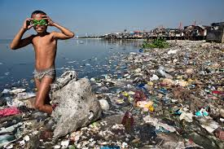
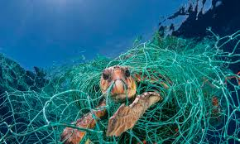
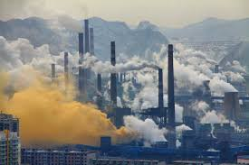
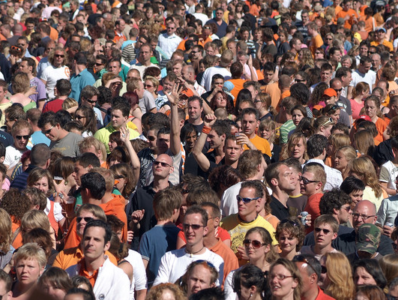
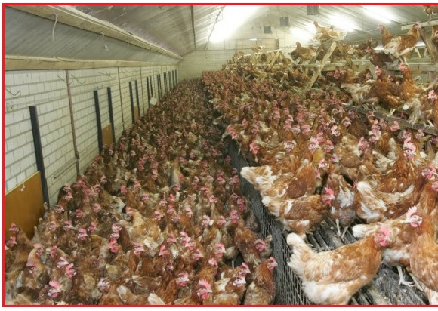
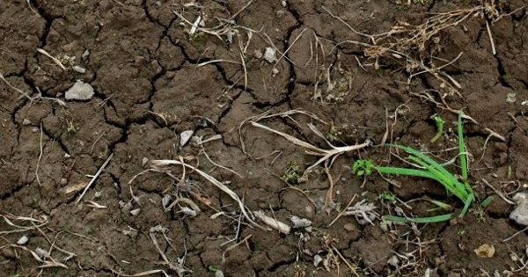
Why?
Leerlingen zeiden: “Je MOET hem loslaten.”
Hij hield vol: “Dat moet niet. Ik heb daar mijn reden voor.”

Slide 3

Who?

Slide 4
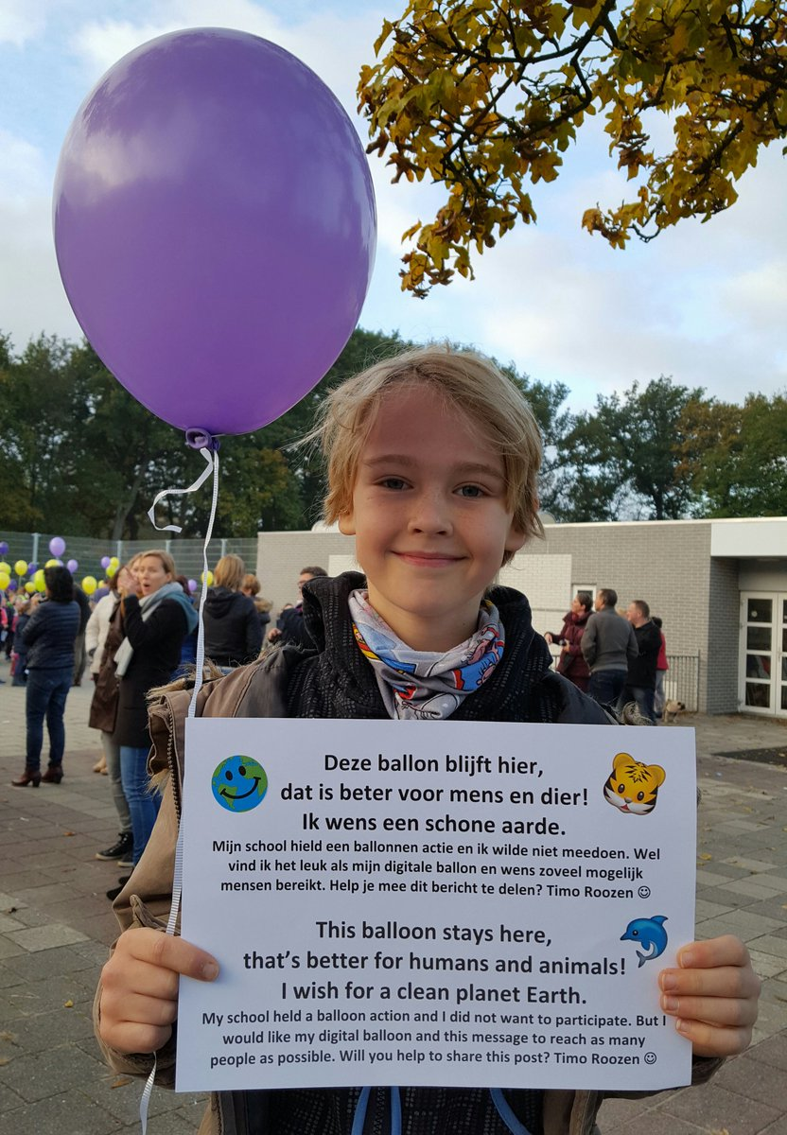
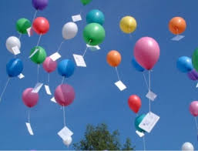
Who?
Leerlingen zeiden: “Je MOET hem loslaten.”
Hij hield vol: “Dat moet niet. Ik heb daar mijn reden voor.”
This balloon stay here,
It’s better for humans and animals
I wish a clean Earth!
Timo Roozen

Slide 5
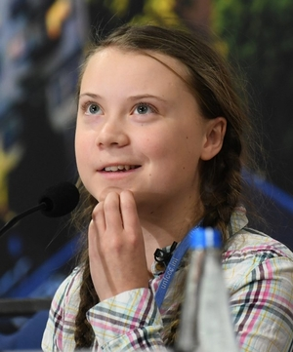
Who?
Greta Thunberg : You didn’t act in time!
She changed her parents and then became an opinion leader world wide.
“Doing our best is not enough.

Slide 6
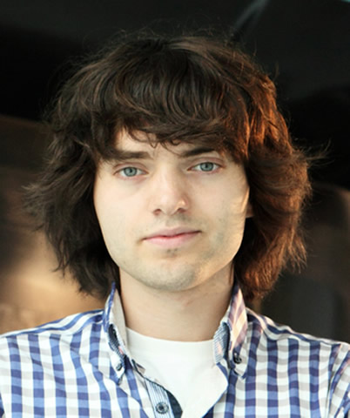
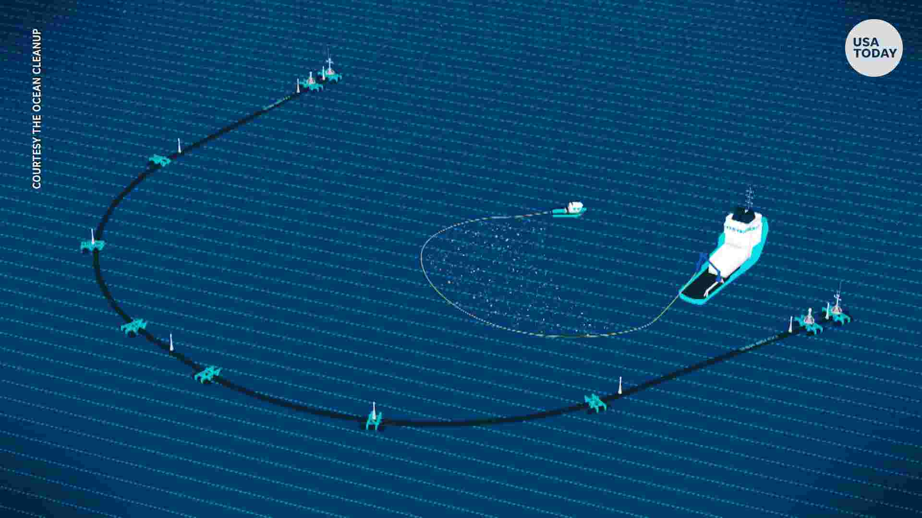
Who?
Our models indicate that a full-scale system roll-out could clean up 50% of the Great Pacific Garbage Patch in 5 years.
Boyan Slat

Slide 7
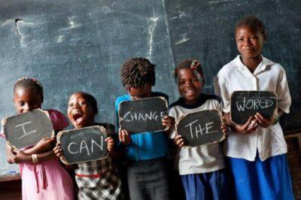
Who?
Leerlingen zeiden: “Je MOET hem loslaten.”
Hij hield vol: “Dat moet niet. Ik heb daar mijn reden voor.”

Slide 8
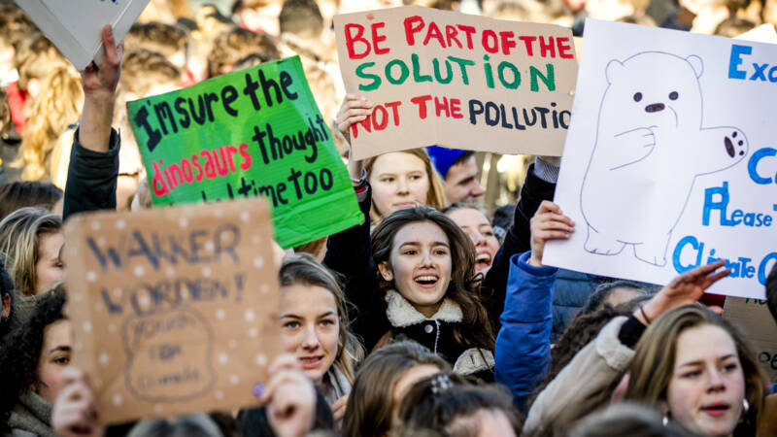
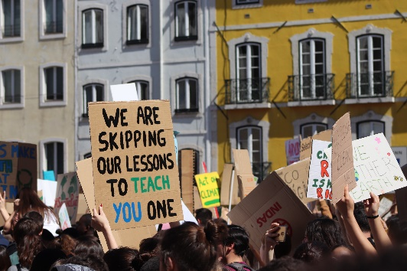
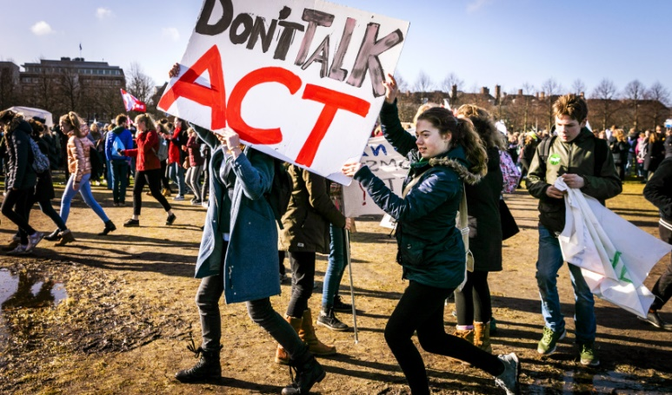
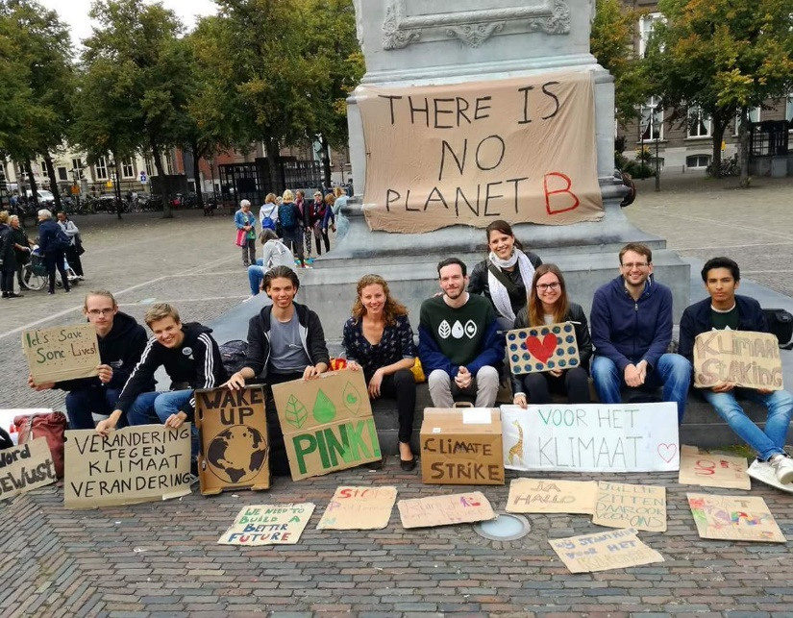
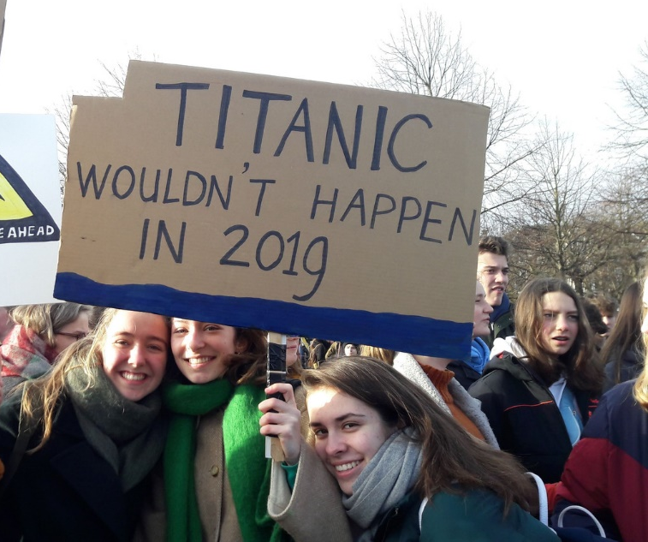
Who?
Leerlingen zeiden: “Je MOET hem loslaten.”
Hij hield vol: “Dat moet niet. Ik heb daar mijn reden voor.”

Slide 9
So:
Student led change!

Slide 10
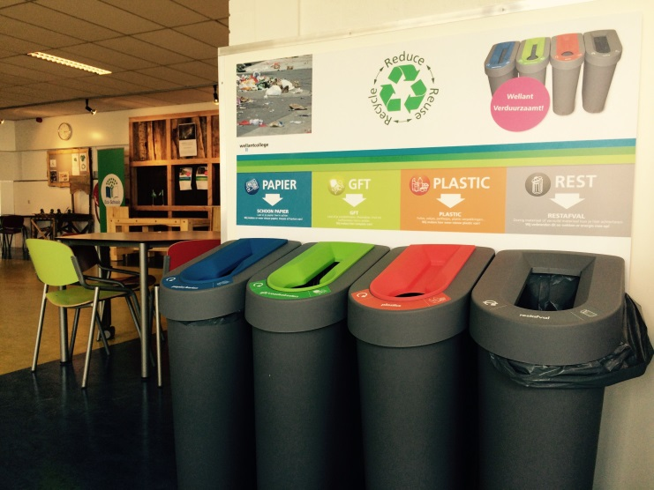
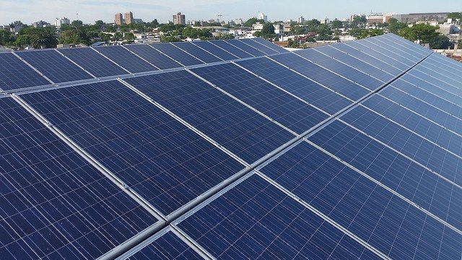
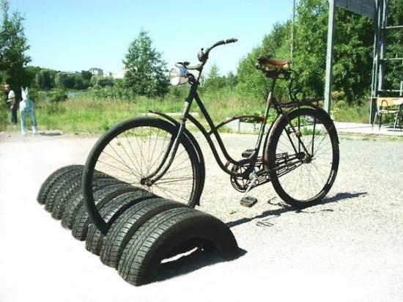
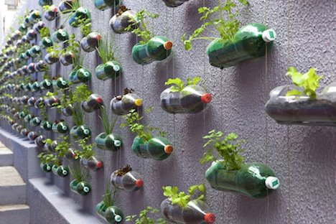
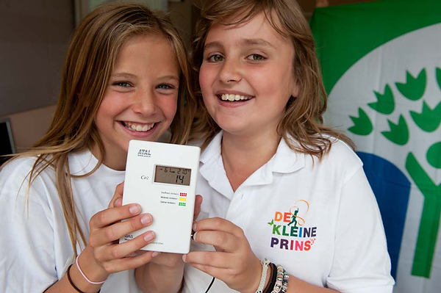
What?

Slide 11
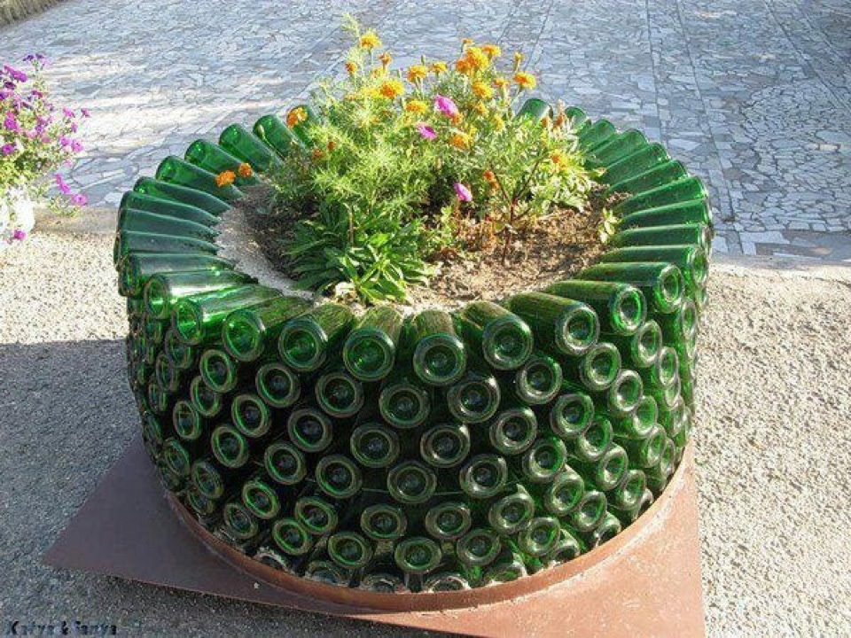
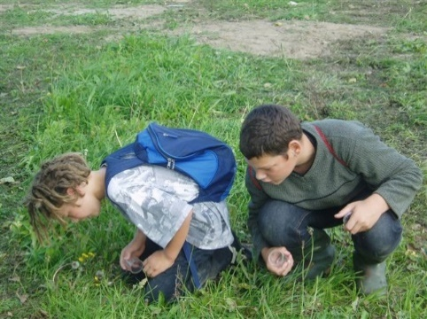
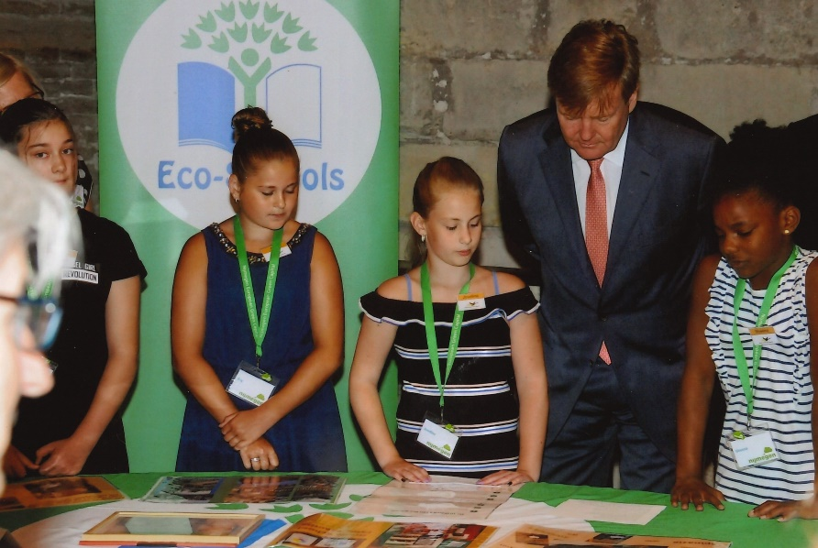
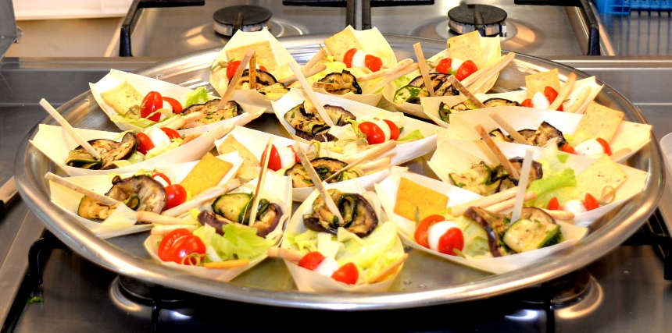
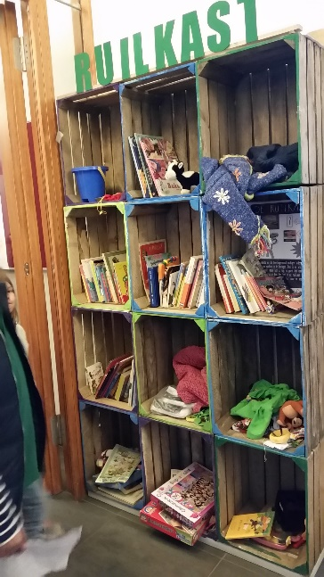
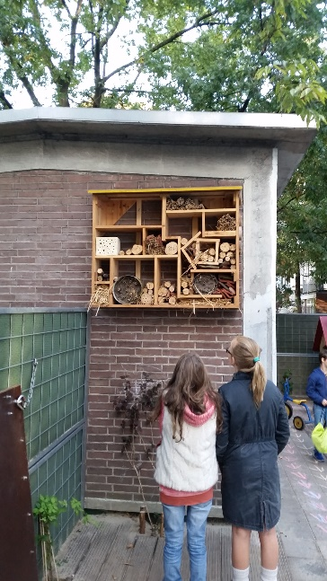

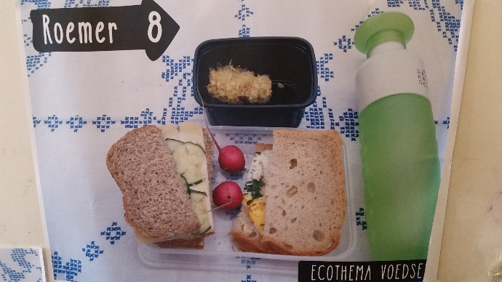
What?

Slide 12

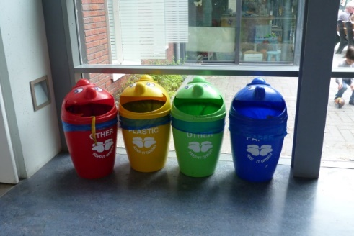
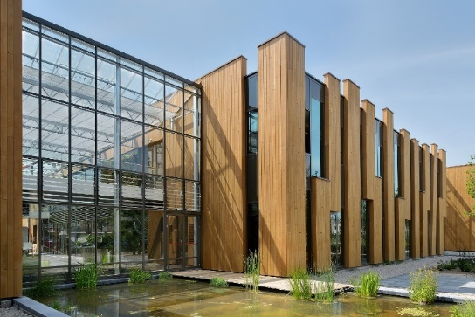
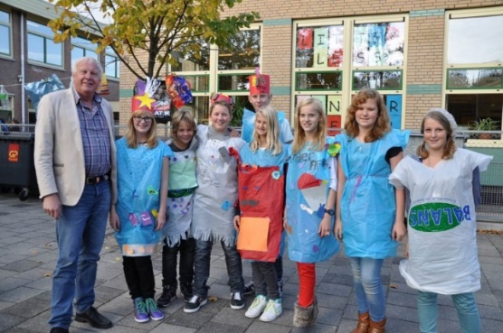
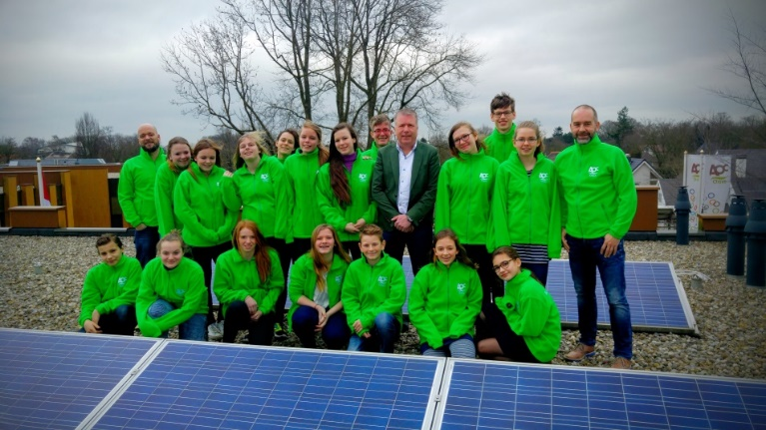
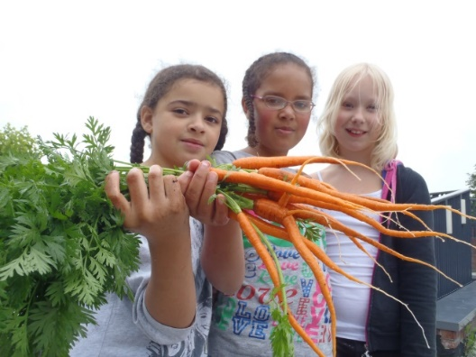
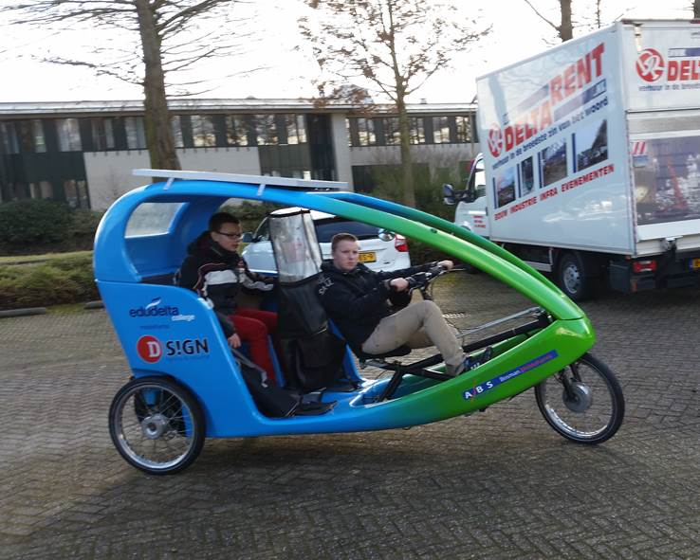
What?

Slide 13

What?

Slide 14
How?
Can we change behaviour?
https://www.youtube.com/watch?v=rQNnwjew1w8

Slide 15
Eco-Schools
The Eco-Schools program

Slide 16
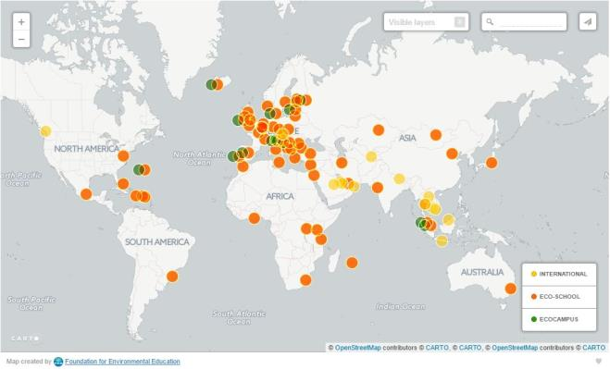
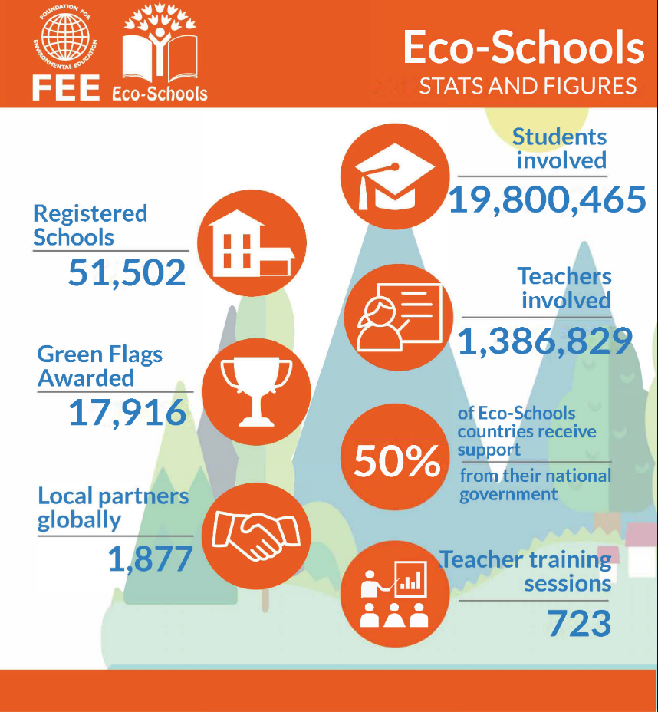
Eco-Schools

Slide 17
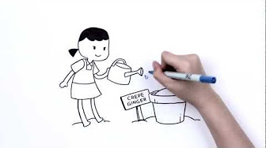
Eco-Schools
https://www.youtube.com/watch?v=NYnTmgnUmmo&feature=youtu.be

Slide 18

What is Eco-Schools?
Process of Sustainable Change
For Primary, Secondary, Vocational Schools and Universities
7 steps
10 themes
Student led change
Process is more important then savings and projects
Award (no teaching materials)
UN lauded program
Assessment every two years
ISO approach: chose your own approach and do it
Assessment looks at
Environmental review, Plan, Execution, Monitoring
Curriculum
Cooperation (inside and outside school)

Slide 19
What is Eco-Schools?
Structure
Change the current situation
Chose your themes as school
Curriculum
Sustainable education
No extra’s, but integrated
Sustainable curriculum with methods, activities and cooperation
Results
Raises awareness & changes behaviour
Promotes sustainable actions
Sustainable Change
Reduction and savings
Distinctive and publicity

Slide 20
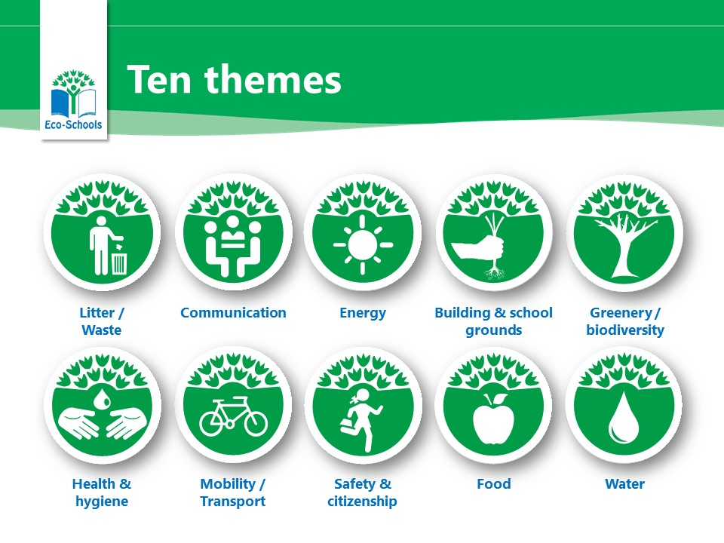
Eco-Schools: 10 themes
05-06-2019

Slide 21

Sustainable Development Goals

Slide 22
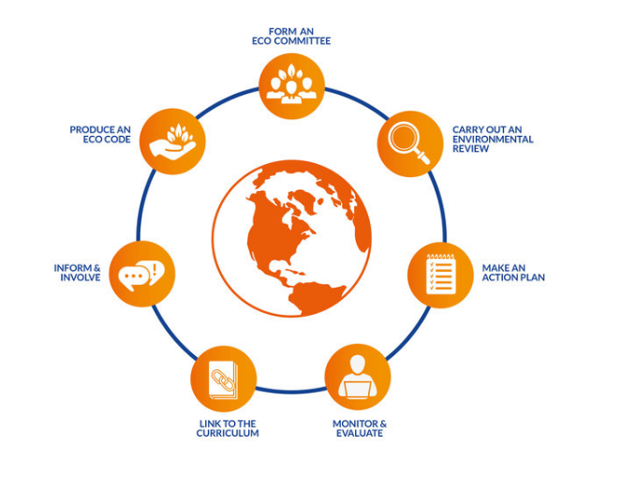
Eco-Schools: 7 steps

Slide 23

“Whole-school approach”
Sustainability embedded in methods and activities
Student-led change: fun,
action oriented programme
School building and surroundings as learning materials

Slide 24
The other way around
Old school: knowledge -> attitude -> behaviour
Today: Behaviour -> attitude -> knowledge

Slide 25
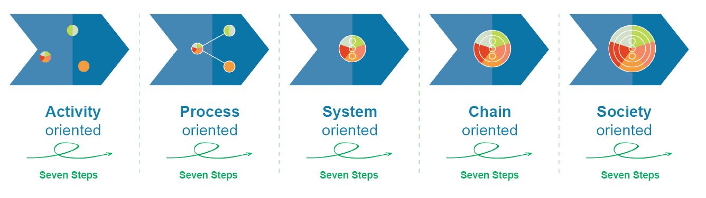
Project -> process

Slide 26
Project -> process
Projects related with the themes the school selected (with visable changes for students)
Connection of education with the school building (school = a company) and surroundings
Integration in the curriculum
Part of the school policy (school plan)
Continuous development and visible changes on our way to a sustainable school
Two way cooperation with society

Slide 27
So…
Make the change you want at school.
Don’t wait for others, find companions and go
Don’t take no for an answer: it is your future
Don’t forget: sustainability is fun (and a great opportunity)

Slide 28
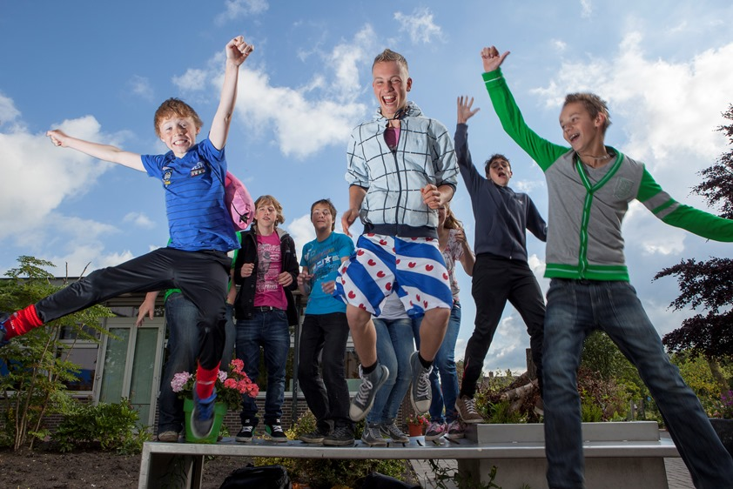
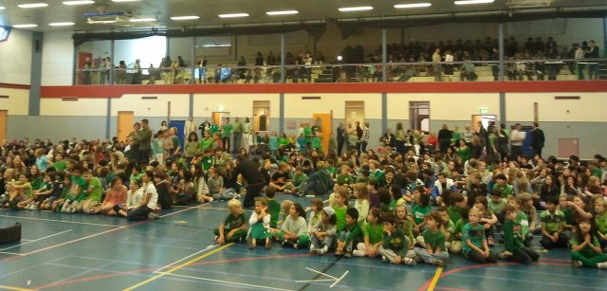
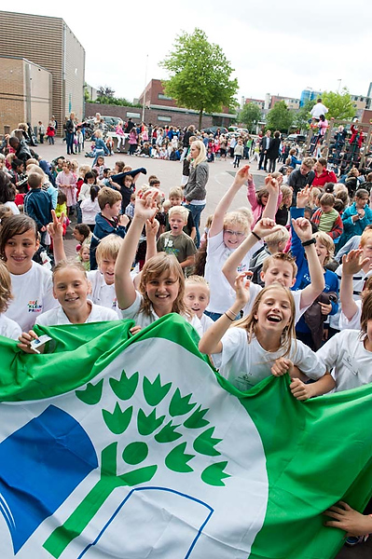
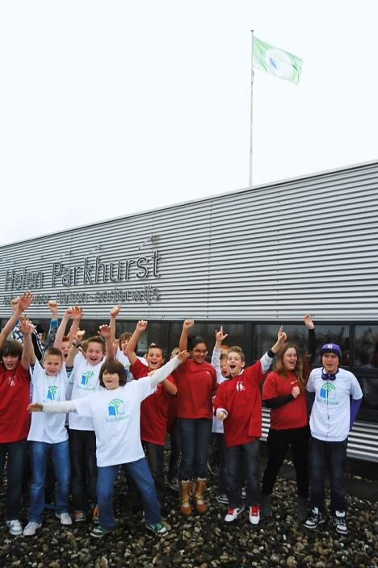

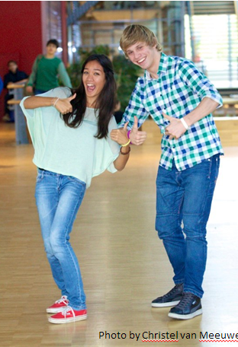
Celebrate!

Slide 29
Eco-Schools: 7 steps
1
Eco-team
Green Flag
(after 2 years)
7
Eco-code
2
Eco-scan
6
Inform and involve
3
Action plan
Silver certificate
(after 1½ year)
5
Curriculum
4
Realise and monitoring
Bronze certificate (after 1 year)

